Slide 1
YEAR’S REPORT ON EMERGING SKILLS
IBM Data Analytics Capstone Project
ALEXANDER NELSON LEAÑO
IBM │ CURSERA
June 3rd, 2021
Notes:
erterterterterterte

Slide 2
OUTLINE
Executive Summary
Introduction
Methodology
Results
Visualization – Charts
Dashboard
Discussion
Findings & Implications
Conclusion
Appendix

Slide 3


EXECUTIVE SUMMARY
We work with the stack Overflow Developer Survey 2019
We are looking for analyze:
Current technology usage
Future Technology Trends
Demographics
For the analysis we are going to use CDE (Cognos Dashboard Embedded) and Jupyter notebook.

Slide 4

INTRODUCTION
Keeping pace with technology change
Analyzing data to identify future skill requirements
Question to answer:
What are the top programming languages in demand?
What are the top database skills in demand?

Slide 5
METHODOLOGY
Data sources
GitHub Job postings
Programming Languages Annual Salary
Stack Overflow Developer Survey 2019
Data imported into IBM Cogno Dashboard Embedded (CDE)
Randomized subset with 1/10th of the of the original data set
Process:
Data exploration
Data wrangling
Data exploratory analysis
Data visualization using CDE
Data presentation

Slide 6
RESULTS
Programming language trends
Data base trends
Current technology usage
Future technology trend
Demographics

Slide 7
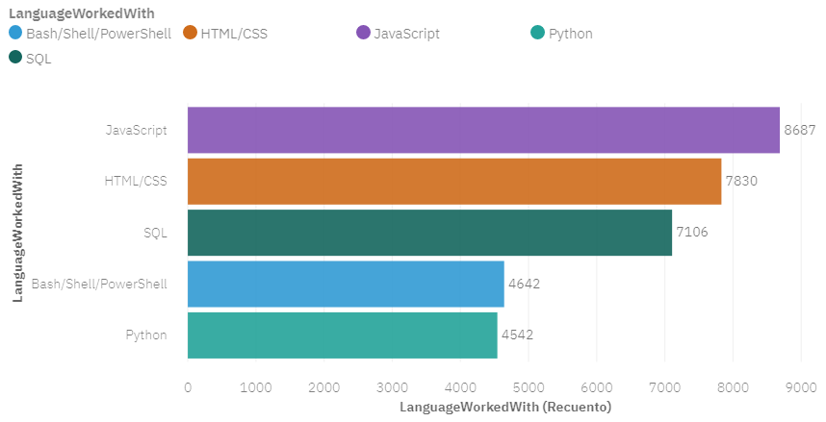
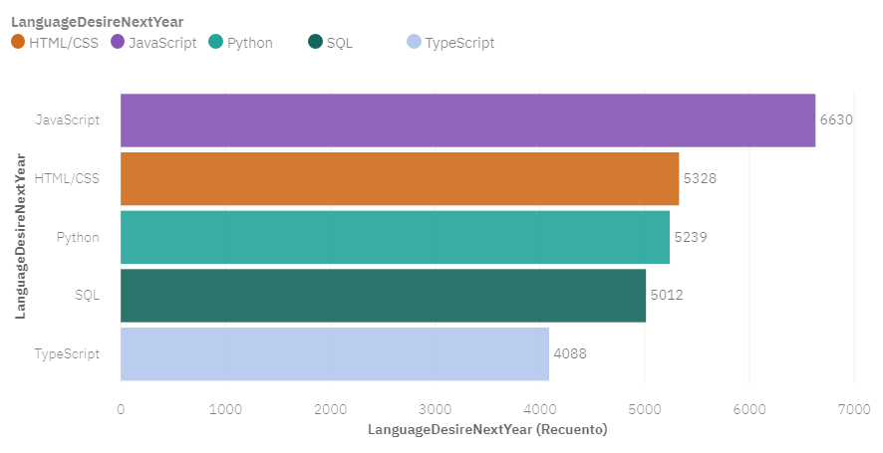
PROGRAMMING LANGUAGE TRENDS
Top 5 Programming Languages
Current Year
Top 5 Programming Languages
Next Year

Slide 8
PROGRAMMING LANGUAGE TRENDS
FINDINGS & IMPLICATIONS
FINDINGS
JavaScript and HTML/CSS are the most popular programing language this year and still will be the next year.
Python go up in the next year
SQL still in top 4
TypeScript in top 5 in the next year
IMPLICATIONS
Web technologies are habitually in demand and growing.
Typescript is going to be an important skill to learn

Slide 9
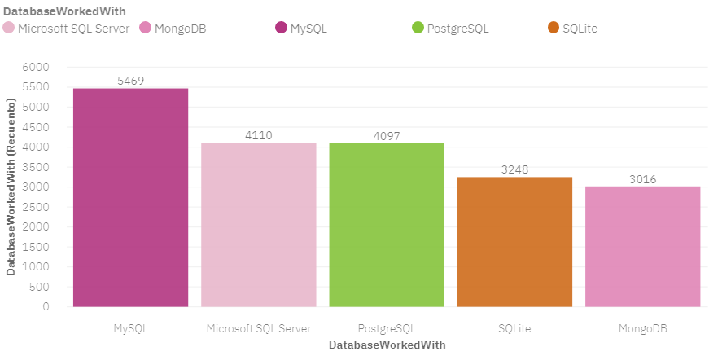
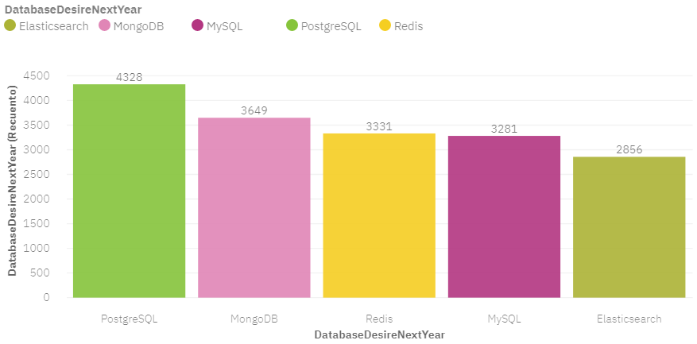
DATABASE TRENDS
Top 5 Databases
Current Year
Top 5 Databases
Next Year

Slide 10
DATABASE TRENDS
FINDINGS & IMPLICATIONS
FINDINGS
Increase of interest in PostgreSQL and MongoDB
MySQL still in top 5
Microsoft SQL Server and SQLite were replaced for Redis and ElasticSearch
IMPLICATIONS
MySQL is still trending, but Microsoft SQL Server may be not.
NoSQL (MongoDB, ElasticSearch) are becoming more popular in the next year.
Open-source database are habitually in high demand
Redis and ElasticSearch became emerging popular databases the next year.

Slide 11


METHODOLOGY
Cognos dashboard

Slide 12
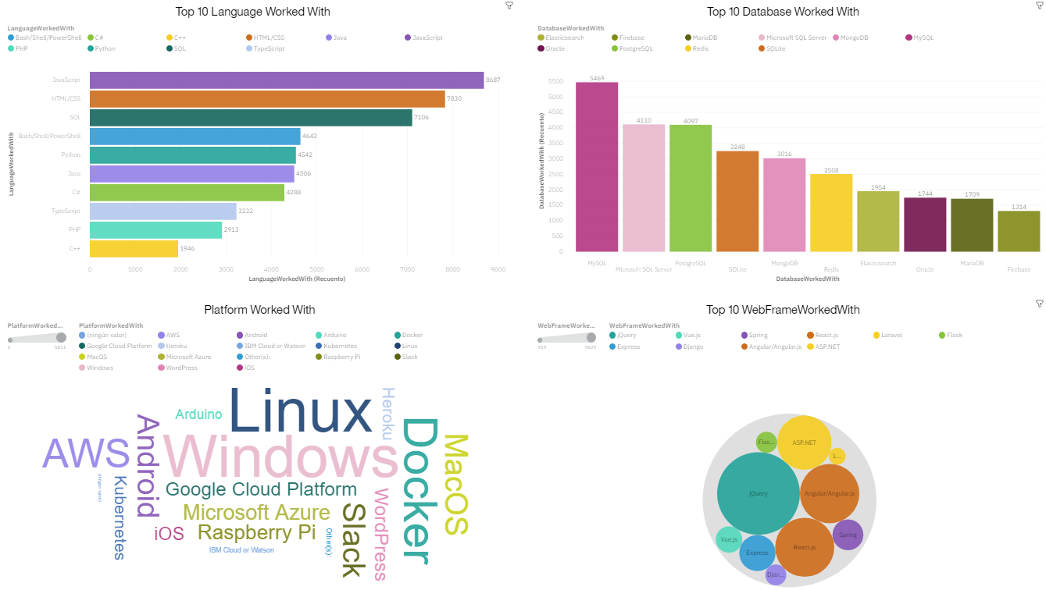
DASHBOARD TAB 1
Current Technology Usage

Slide 13
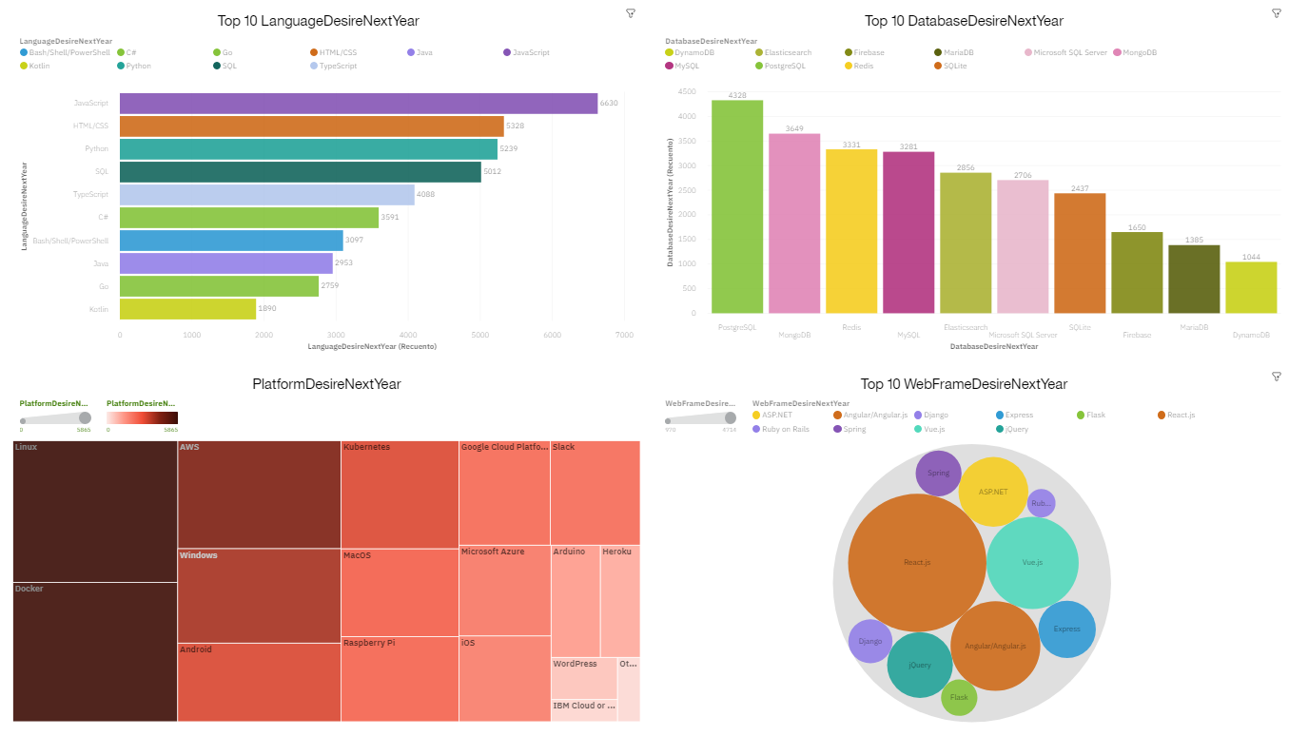
DASHBOARD TAB 2
Future Technology Trend

Slide 14
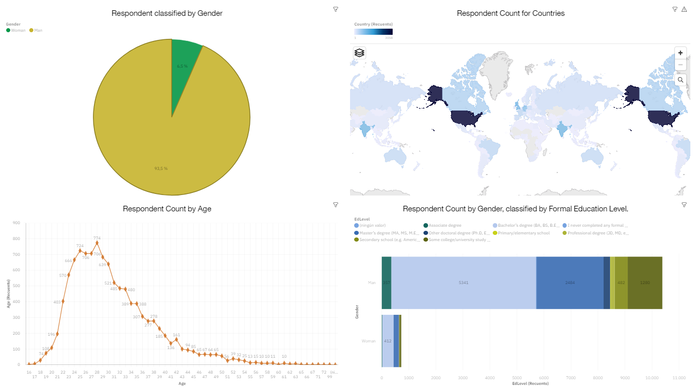
DASHBOARD TAB 3
Demographics

Slide 15
DISCUSSION
Typescript vs JavaScript: JS still hot but is important to keep Typescript in sight.
Bash/Shell/Power Shell in the top 10
Data with a 93,5% of Men vs 6,5% of Women.
50% of respondent between 25 and 35 years old.
The major part of respond from USA.
Database trend changes more dynamic than Programing Language.

Slide 16
OVERALL FINDINGS & IMPLICATIONS
Findings
Many more men than women participated in the survey.
Programing Language are not going to change significantly in the next year.
Database change more significantly in the top 5.
Oracle is not in the top 10 in the next year.
Implications
Needed of data to analyses implications about gender.
Needed of data to analyses implications about countries.
JavaScript, HTML/CSS and SQL are very important to developers.
Platforms like Windows, Linux, Docker and AWS are really important to know.

Slide 17

CONCLUSION
An analysis of programming language and Database skills for next year was performed with valuable insight.
Many statistical tool were be used in order to perform the successful analysis.
This kind of analysis help to keep pace with technology change and identify future skill requirements successfully.

Slide 18

APPENDIX

Slide 19
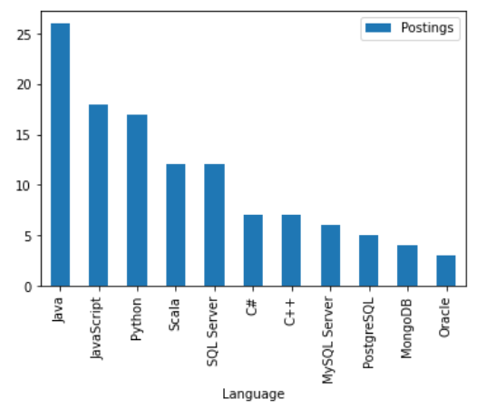
GITHUB JOB POSTINGS

Slide 20
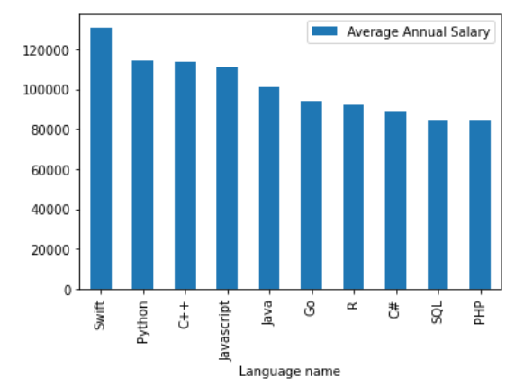
POPULAR LANGUAGES

Slide 21
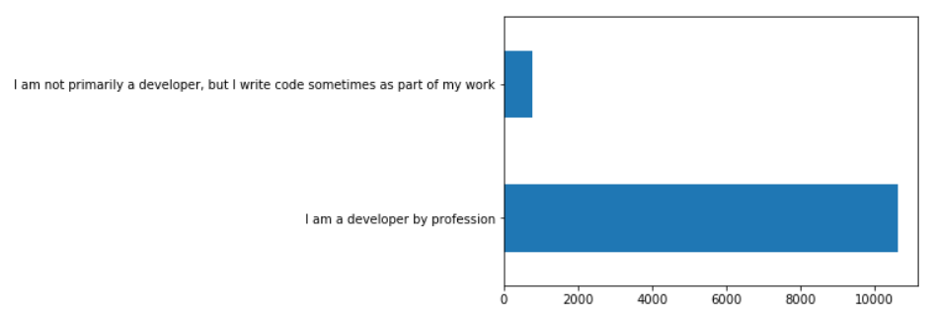
Main Branch

Slide 22
Thank You!

